Slide 1
Tracking the effect of temperature on the amplitude and frequency of a filament using Matlab and FIJI
Anikait Singh
School: West Windsor-Plainsboro High School South
Advisor: Dr. Gordon Thomas and Dr. Camelia Prodan
Mentor: Arooj Aslam
Biophysics
NJIT
July 25. 2017

Slide 2
Concepts Used
Microtubules
Harmonics/Modes

Slide 3
Specific Objectives
Experiments
Used a String oscillating at a mode as a control to determine the accuracy of the tracking algorithm
Analyzed effect of temperature on the amplitude and frequency of the microtubule
Code Changes
Nearest neighbor algorithm created to account for the changing number of points per frame (track points over time)
Used MIJ plugin to connect Matlab to image processing software

Slide 4
Background
Analyzing Taxol stabilized Microtubules
Stuck Down Microtubule
Moving Microtubule

Slide 5
Matlab Program (Aslam, et al)
Import points from the JFilament Program
Reduce the noise in the background of the image
Mean Filter
Gaussian Filter
Filament Reconstruction algorithm
Creating a spline to interpolate points
Rotating a part of the Microtubule and looking at intensity values to determine position
Fourier Transform
Determines a combination of a sine and cosine function that best fits the Microtubule
Nearest Neighbor Algorithm

Slide 6
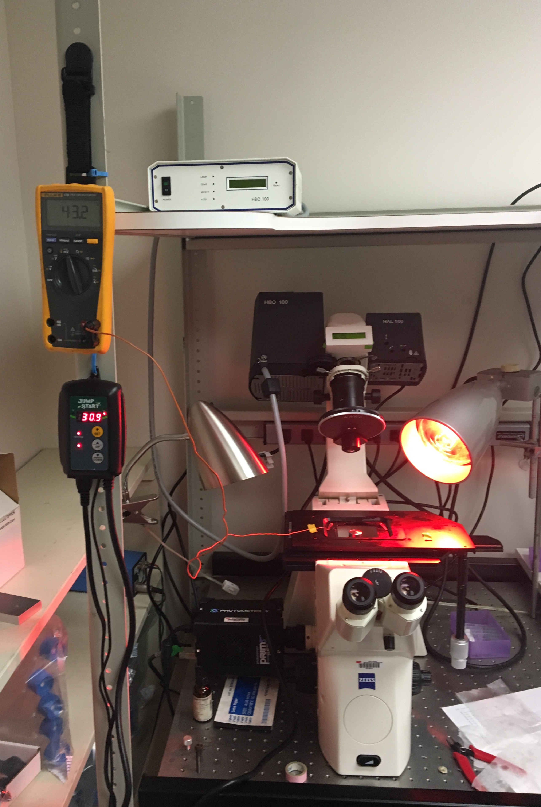
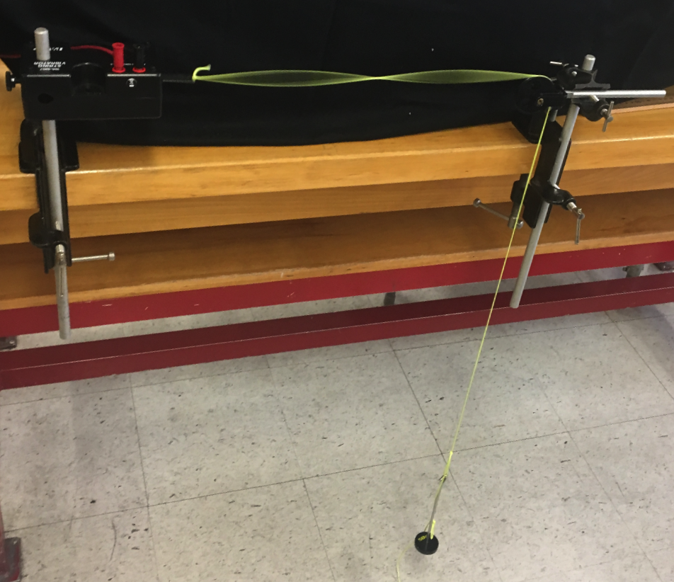
Setup
Temperature Experiment
String Experiment

Slide 7
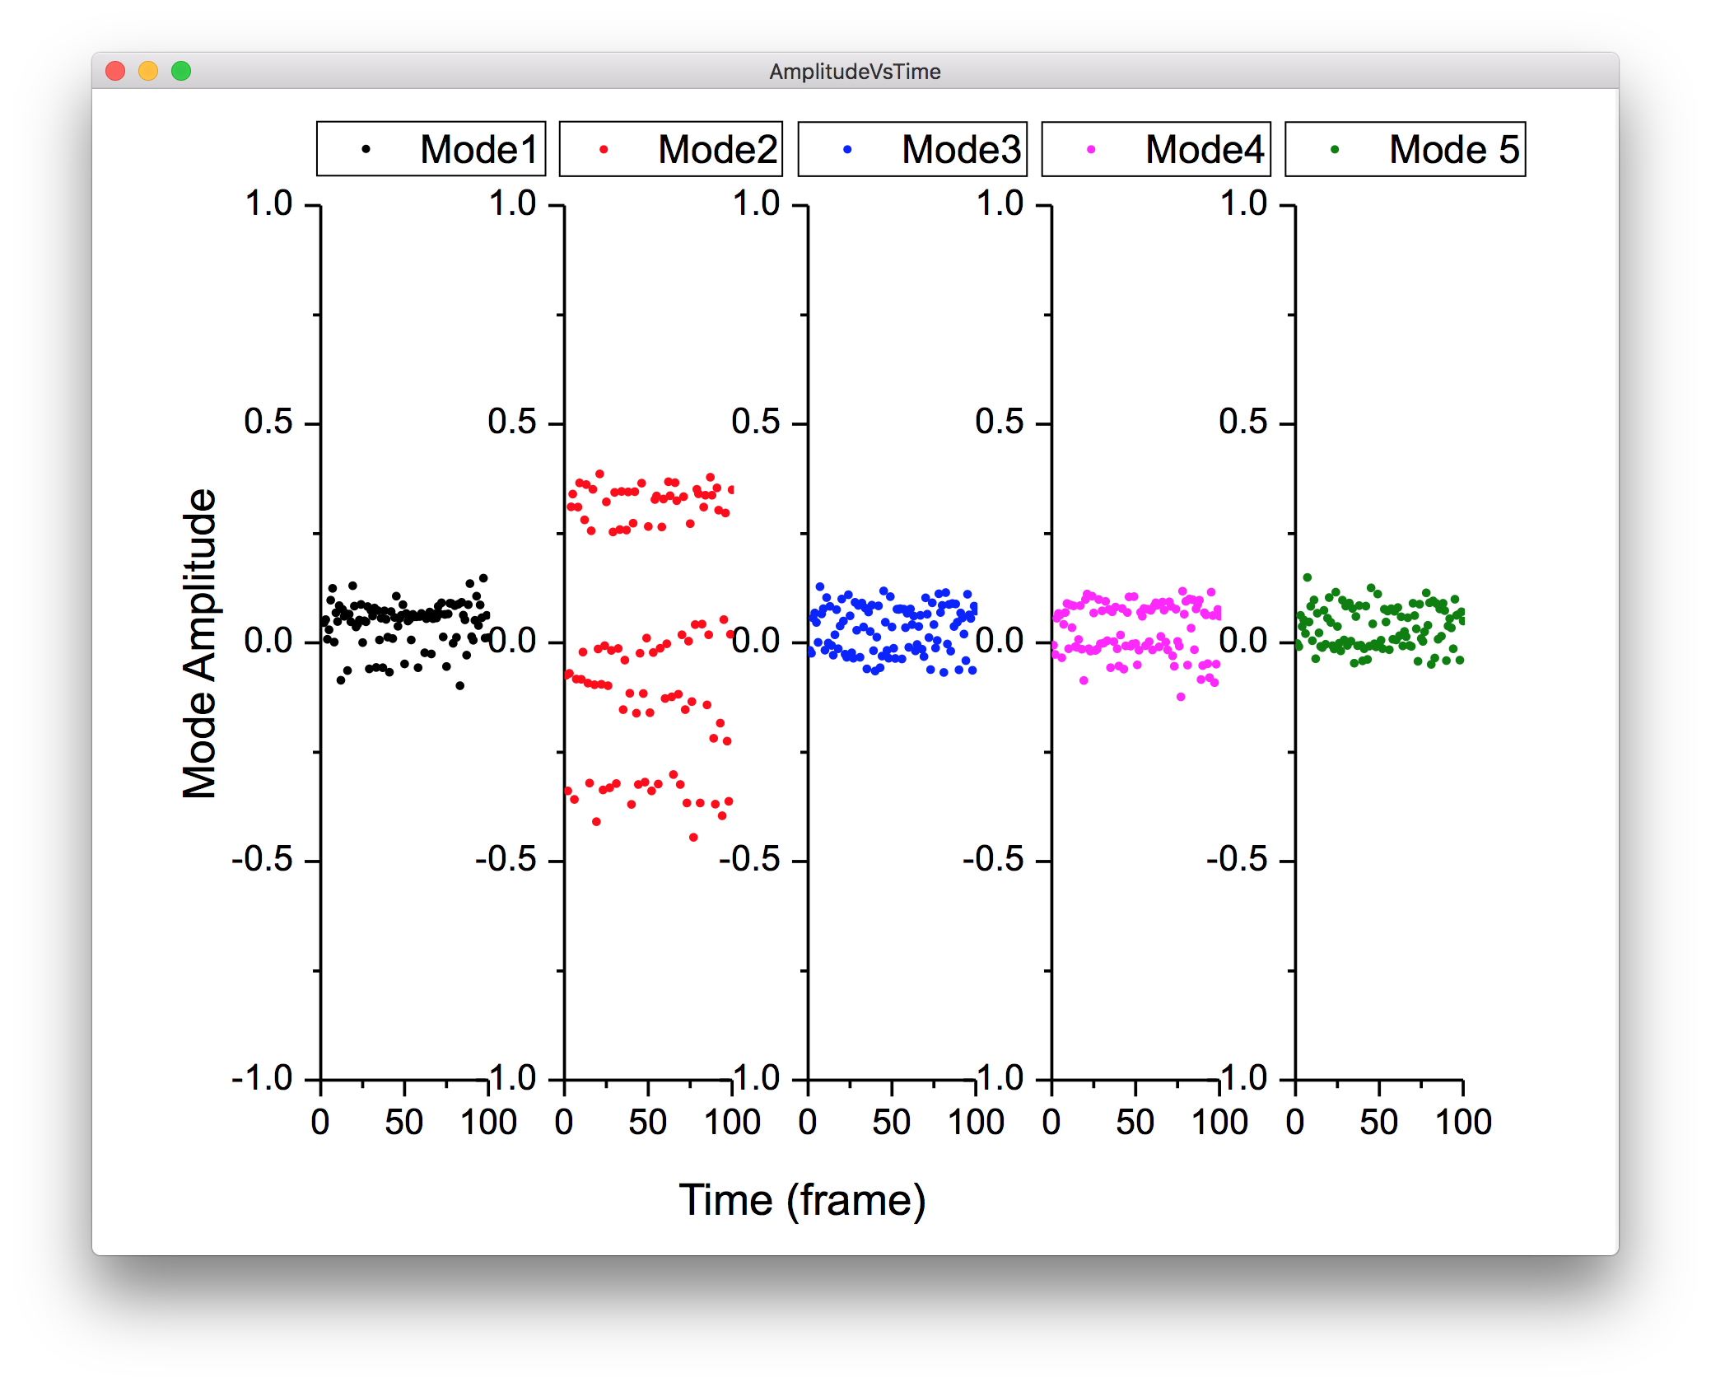
Results — String Experiment
Algorithm works only in certain frame rates. It is necessary to control that frame rate when recording videos of the microtubules.

Slide 8
Results — Temperature Experiment

Slide 9
Conclusion and Future Work
Conclusions
Confirmed that the algorithm from Brangwayne Paper is successful
Determined the importance of Frame Rate in capturing videos of microtubules (has an impact on the accuracy of a calculation)
Future Work
Determine the bounds for temperature on the stabilizing nature of Taxol for Microtubules

Slide 10
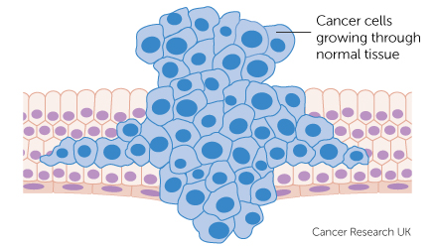
Significance
Significance
Microtubules are used in cell reproduction
Analyzing there motion and the effect of the temperature can determine at which temperature it is best to perform chemotherapy (as the microtubule would be unstable)

Slide 11
Acknowledgements and References
Acknowledgements.
New Jersey Institute of Technology Provost Program
Dr. Thomas, Dr Camelia Prodan
Arooj Aslam
Angela Retino
NJIT High School Provost
The Keck Foundation
References
Brangwynne, Clifford P., et al. “Bending Dynamics of Fluctuating Biopolymers Probed by Automated High-Resolution Filament Tracking.” Biophysical Journal, vol. 93, no. 1, 2007, pp. 346–359.
Gittes, F. “Flexural Rigidity of Microtubules and Actin Filaments Measured from Thermal Fluctuations in Shape.” The Journal of Cell Biology, vol. 120, no. 4, 1993, pp. 923–934.

